Slide 1
Coffee Talk with the Counselor
Navigating the World of
College and Financial Aid
10/30/14
Amanda Carden
FCA School Counselor

Slide 2
Class Registration
acceptance
deadlines
advising
Overwhelmed??
Test Scores
Grades
deadlines
Financial Aid
Essays
Deadlines
Time Management
Admissions
Applications

Slide 3
Overview for This Morning
Choosing a Career
Choosing a College
ACT and SAT Tests
Applying to Colleges
Financial Aid Basics
Applying to Scholarships

Slide 4
Choosing a Career
Your child will likely need guidance and reassurance.
Tell your child what you could see them doing. Just don’t choose for them.
Consider your child’s strengths, interests, abilities, and passions.
Goal: Money and/or happiness?
Research, research, research!
Still not sure? It’s okay! First two years general education classes.

Slide 5
Online Assessments (Choosing a Career)
Career Assessments on CFNC:
https://www1.cfnc.org/Plan/For_A_Career/Learn_About_Yourself/Learn_About_Yourself.aspx
Holland Code Assessment:
http://www.roguecc.edu/Counseling/HollandCodes/test.asp
Collegeboard MyRoad:
https://myroad.collegeboard.com/myroad/navigator.jsp

Slide 6
Choosing a College
What are you looking for? Size, affiliation, specific major, location, extracurriculars, cost
Don’t NOT look at private schools because of cost.
VISIT colleges, ask questions
Research, research, research!
Make list, narrow it down
Compare colleges: https://bigfuture.collegeboard.org/compare-colleges

Slide 7
ACT and SAT Tests
Why take them?
Preparing for tests: PSAT results, Khan academy, online practice tests through Collegeboard/ACT sites
Have score reports sent to colleges
ACT: $54.50
SAT: $52.50
(PSAT scores and feedback in December)

Slide 8
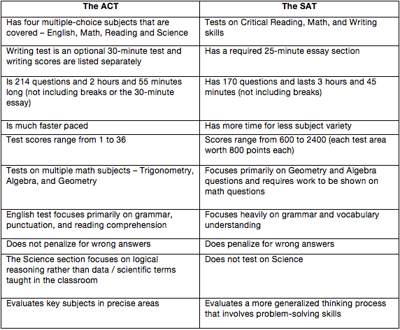
ACT Versus SAT

Slide 9
Registering for SAT/ACT
Usually taken Spring of Junior year, Fall of Senior year.
SAT- Dec.6 test date: Register by Nov. 6
Jan.24: Register by Dec.9
Mar. 14: Register by Feb. 14
May 2: Register by April 6
ACT- Dec. 13 test date: Register by Nov.7
Feb. 7: Register by Jan. 9
Apr. 18: Register by Mar. 13
Jun. 13: Register by May 8

Slide 10
Applying to Colleges
Go to college website, click on admissions, apply.
Websites to simplify the process: Commonapp.org, CFNC.org
Apply to 3-4 schools
Pay attention to deadlines (fees)
Visit colleges to get a feel for the campus
How to stand out from other applicants: volunteer, leadership opportunities, community involvement

Slide 11
Financial Aid Basics
College is expensive, but worth it.
Don’t decide against private schools because of money- higher cost means higher scholarships offered.
Expect some debt.
FAFSA (FREE Application for Federal Student Aid)
Uses complex formula to determine financial aid eligibility.
Complete after Jan. 1. after filing taxes (fafsa.ed.gov)
Will need to apply for a PIN (PIN.ed.gov)

Slide 12
Types of Financial Aid
Scholarships
Grants
Loans
Work-Study

Slide 13
Applying to Scholarships
https://studentaid.ed.gov/types/grants-scholarships/pell
Where to find scholarships:
Ask colleges you are interested in if you will automatically be considered for their scholarships. Don't forget to check your intended major's page for scholarships!
Local Scholarships- Some employers and community organizations may offer scholarships.
State Scholarships- Some scholarships exist for students in a particular state
National Scholarships are often more competitive, but will often offer more money than local or state scholarships.
Scholarship Search Engines: Fastweb.com, Collegeboard.com, Scholarships.com
Participants in School Organizations such as Beta Club

Slide 14
Scholarship Tips
Start searching for scholarships as soon as possible.
Pursue less competitive scholarships.
Don’t miss deadlines.
Read and follow the instructions carefully.
Tailor your essay application to the sponsor’s goals.
Personalize your essay and be passionate.
Use professional email address, such as first.lastname@gmail.com.
Apply to every scholarship for which you are eligible.
Proofread your essay.
Make a copy of all applications.
Keep track of what scholarships you apply for.
Make it a part-time job in high school.

Slide 15
Other Tips for Saving Money
RENT text books.
Get a part-time job
Keep applying to scholarships each year
Make a budget, stick to it. (load a debit card each month)
Living on campus- become a RA (Resident Advisor) for reduced room and board
Learn how to cook (meal plans are expensive!)
Live on campus or at home. Off campus housing more pricy.
Start at community college, transfer to university
Pay interest on student loans. You’ll thank yourself.
If your child uses a credit card to build credit, make sure it’s completely paid off each month.

Slide 16
Resources and Links
Make a Plan for College: Here’s a step-by-step road map to college. Get advice on what to do when and track your progress.
Countdown to College Blog- This blog is designed to help upper school families stay focused on approaching each step of the college selection process with a God-centered perspective. It is written by Jodi Foxx, the Director of College Counseling at Charlotte Christian School.

Slide 17
Other Questions You Asked
FTCC classes and college enroll as Freshman
Fee Waivers: Check individual sites for application
Transcripts: See Tracy. FTCC transcripts from the college.

Slide 18
Additional Questions?
(Email me: amandac@fccministries.com)

